Slide 1
Unlocking Automotive Trends with Data Analytics
By
Vinay Simha M K
Batch code: ML3-DA23

Slide 2
Objectives:
The objective of the project is to analyze a car dataset to gain insights into popular trends and identify key factors for launching promising car models. Extract actionable insights from the given data, addressing key areas such as categorizing cars based on market segmentation, conducting fuel efficiency analysis, comparing performance, studying weight distribution, assessing safety features, exploring user comfort, analyzing alert systems, and conducting dimensional analysis
Area of Focus and Analysis.
Market Segmentation Analysis
Fuel Efficiency Analysis
Performance Comparison Analysis
Weight Distribution Analysis
Safety Feature Analysis
User Comfort Analysis
Alert System Analysis
Dimensional Analysis

Slide 3
About the Dataset:
The dataset consists of 1277 records and 139 columns. And is related to Car Manufacturers
and features.
Make(Manufacturer), Model and Variant together gives car name.
Fuel Type lets us know whether the car is electric or nonelectric (petrol/diesel etc).
Height, Length, Width gives about the dimension of the car.
Body Type is about about the look of the car whether it’s SUV/Hatchback/Sedan etc.
City/Highway Mileage is about the details related to Mileage in terms of kms/litre.
Kerb Weight is the total weight of the car without load/luggage.
Ground Clearance is the height between ground and car’s under carriage.
Seating Capacity is about the number of seats available inside the car.
Central locking system, Child safety locks, Hill assist, Gear Indicator, High speed alert system,
Passenger side seat belt reminder, ABS, Fasten seatbelt warning, Door Ajar warning is about
extra features related to Assist and Alert features built inside the car.
Cruise control, ASR/Traction control these are related to the safety measure related to speed of the
car where cruise control helps to maintain the car speed without using accelerator and Traction
control helps in regulating the anti-skidding.
Gear shift Indicator is the feature which reminds the driver to shift the gears but in electric this
feature is not there.
Airbags is the special feature available is cars which activates during collision to prevent heavy
injuries to the people.

Slide 4
Business Questions:
What are the popular car body types based on production or manufacturing rate.
Cars that can adapt to various driving modes such as Normal, Comfort, Eco, Sport, Power .
Manufacturers providing best cars based on city mileage.
Manufacturers providing non – electric cars based in city mileage.
Mean, Median of City and Highway Mileage for cars like Hyundai, Mahindra, Renault, Skoda.
Manufacturers providing good average mileage on both City and Highway Mileage.
Relation between Displacement and City Mileage.
Spread of fuel economy for car manufacturers Hyundai, Suzuki, Tata and BMW.
Performance of the car based on factors like Displacement, Cylinders and Valves per cylinder.
Few features affecting the mileages of cars.
Relation between Kerb weight and Gross Weight to understand weight distribution.
Presence of Safety features like ABS, Airbags, Hill assist all together.
Cars which are preferred based on User comfort based on parameters like seatings, central
locking, child safety.
Presence of Alert System like High-speed alerts, Seat belt reminders, Door Ajar Warning all together.
Likeable dimension of cars based on demands.

Slide 5
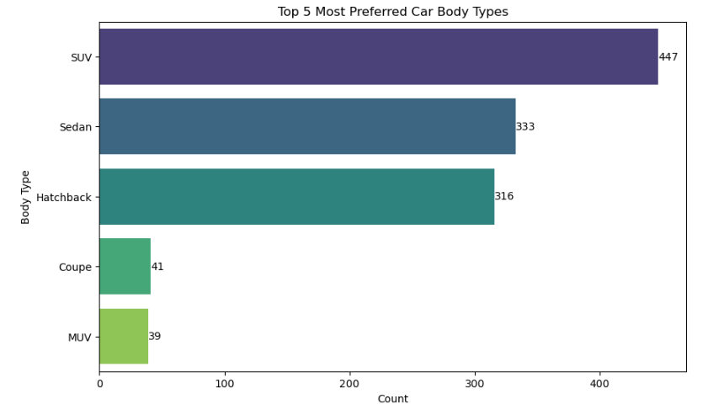
Preferred Car Body Types:
Interpretation:
The top 5 popular car body types are SUV, Sedan, Hatchback, Coupe and MUV.

Slide 6
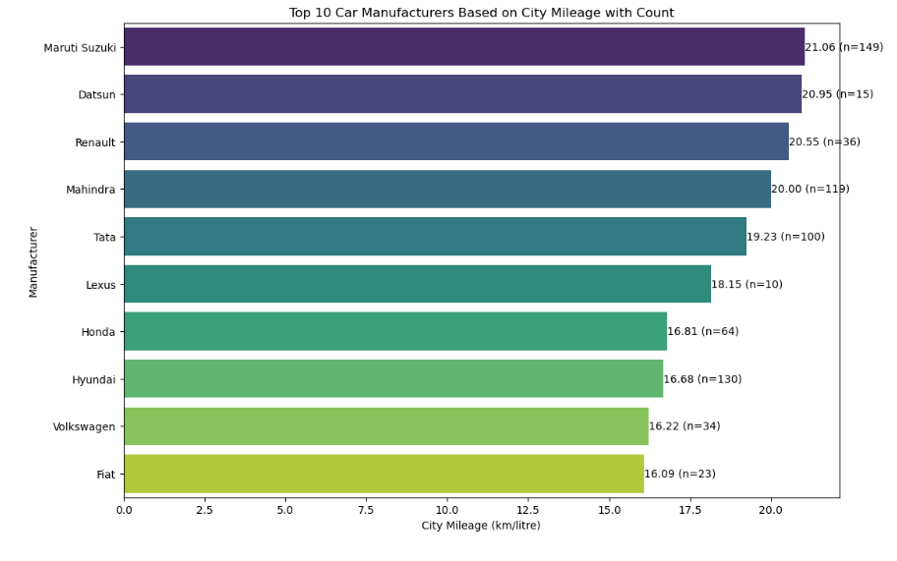
Preferred Manufacturers based on City Mileage:
Interpretation:
The Maruti Suzuki brand has highest average city Mileage of 21.06 and followed by Datsun and Renault which also Provides 20+ average Mileage.

Slide 7
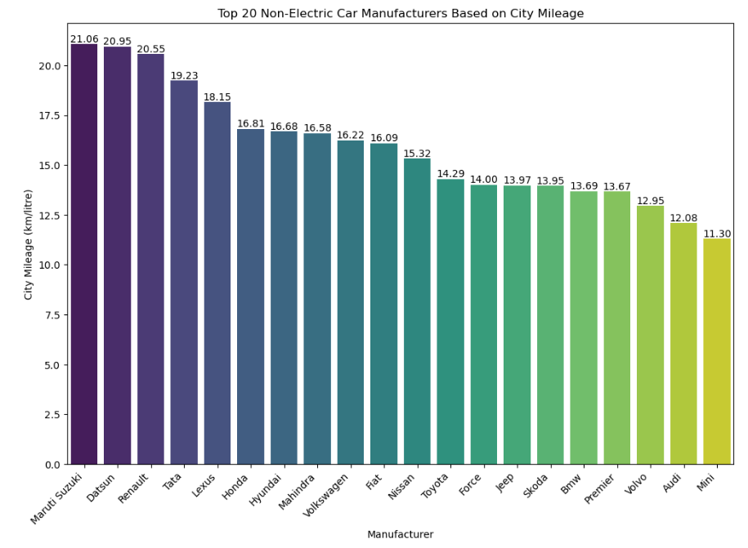
Manufacturers based on non-electric cars:
Interpretation:
The cars manufacturers who are providing nice and high average city mileage are the ones
Manufacturing the high non-electric cars as well.

Slide 8
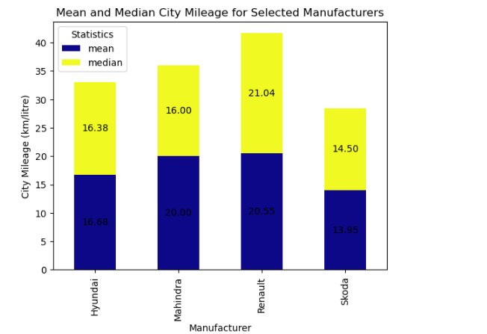
Mean and Median on City Mileage for selected manufacturers:
Interpretation:
The Renault Manufacturer providing cars
which are having nice average city mileage
of 20.55 and the same brand providing
different varieties of cars having the mileage
of 21.04.

Slide 9
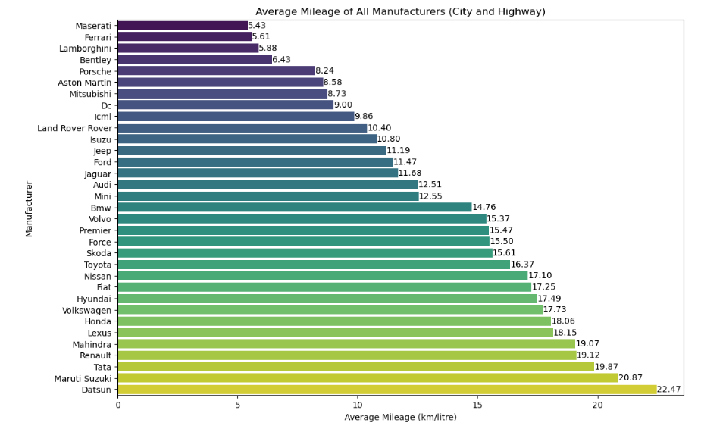
Manufacturers and their combined average City and Highway mileage:
Interpretation: The manufacturers who were providing high city average mileage are the ones providing
the highest in this one but when it comes to super cars like Maserati, Ferrari, Lambo, Bentley, Porsche
these cars are having higher rate of Power and Torque hence providing less mileage

Slide 10
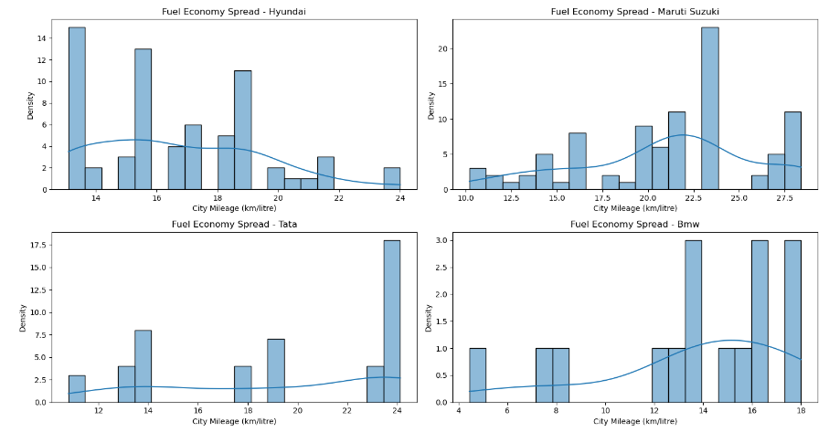
Distribution of Fuel Economy for selected manufacturers:
Interpretation:
From this for the BMW manufacturer the skewness is high.

Slide 11
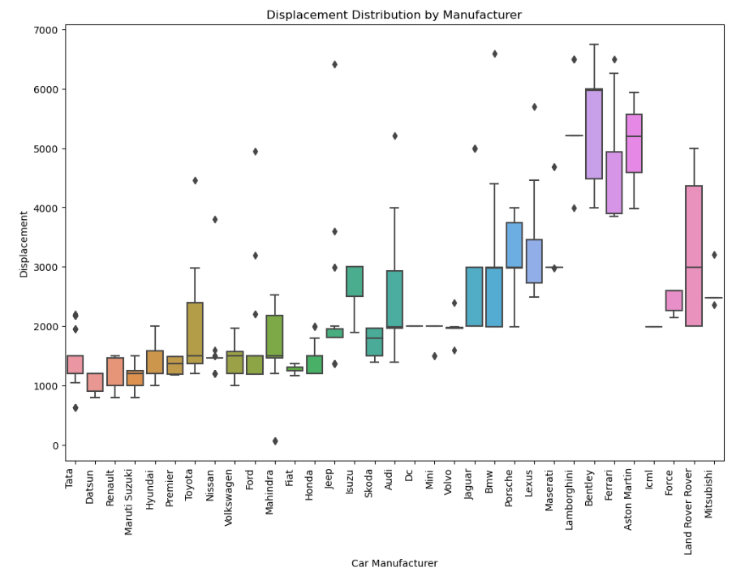
Distribution of Displacement based on Manufacturer:
Interpretation: For the manufacturers which are providing high average city mileage doesn’t have outliers
but other brands since the displacement and mileage are inversely related, they are having outliers.

Slide 12
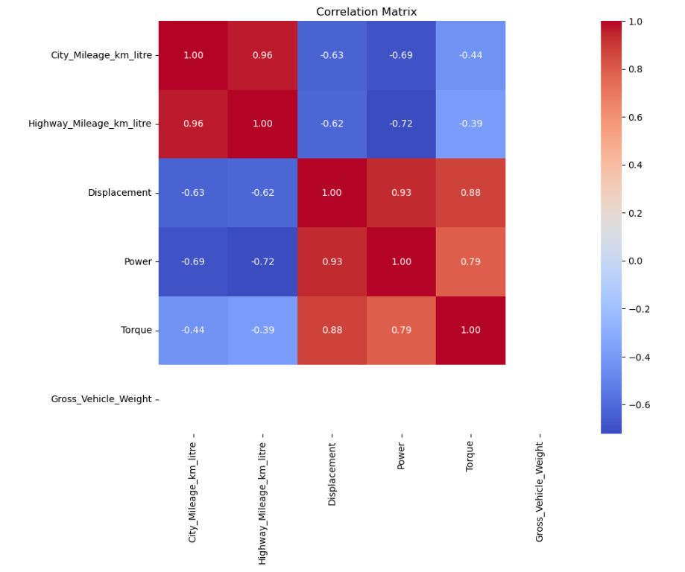
Factors affecting the mileage:
Interpretation: From this we can say that
Displacement, Power and Torque are
inversely related with Mileage (city and
highway) as Mileage increase the above
Values are decreases that’s why the values
Are negative.

Slide 13
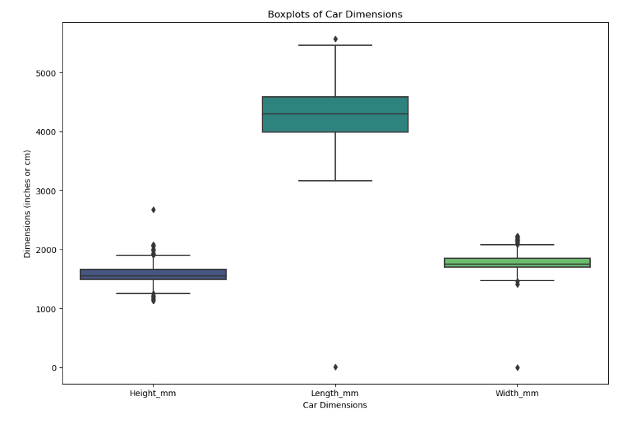
Information related to Dimension of car:
Interpretation:
The preferred car size is liking to have minimum of 1557 mm in height, 4330mm in length and
1770 mm in terms od width. So, this is the most found common size of the cars.

Slide 14
Summary:
The most popular car body types are SUV, Sedan Hatchback, Coupe and MUV.
Only 2 cars among all does all capability to adapt various driving conditions namely Normal, Comfort, Eco, Sport
and Power. And these cars are Audi Q8, Audi A8 L.
The car manufacturers namely Maruti Suzuki, Datsun, Renault, Mahindra and Tata are giving the highest average city mileage.
Since the above-mentioned cards are giving highest city avg mileage the manufacturing rate of nonelectric car is also high.
Among the car manufacturers Hyundai, Mahindra, Renault, Skoda, Renault manufactured cars are providing
highest avg city mileage and does have lots of varieties of cars giving the avg city mileage as 20+kms/liter.
When we consider the fact about both city as well as highway mileage Datsun, Maruti Suzuki, Tata, Renault
and Mahindra are top 5 manufacturers if the customer needs cars for mileage based. And the manufacturers
named Maserati, Ferrari, Lambo, Bentley and Porsche are the cars having higher Power and Torque and having
higher fuel consumption rate. So, the mileage is low compared to others.
In general Displacement and Mileage does have Negative Correlation that is When Mileage Decrease Engine
Displacement Increases and vice versa.
And for the manufacturer BMW there is higher skewed data which represent that they do manufacture different
varieties of cars that has varying mileage.
Around 30% of cars having Safety Features like ABS, Airbags and Hill assist together
Around 65% of cars are manufactured for 2-4 seaters and have central locking system and have Child safety locks inbuild.
There are 20% of cars having all types of Alert Systems together namely High-Speed alerts, seat belt reminders, door ajar warnings.
The preferred car size is liking to have minimum of 1557 mm in height, 4330mm in length and1770 mm in terms of width. So, this is the most found common size of the cars.

Slide 15
Conclusion and Recommendation:
6. Correlation Analysis:
Negative correlation between displacement and mileage.
Recommendation: Consider engine displacement carefully, balancing performance with fuel efficiency in the new model.
7. Safety Features:
About 30% of cars have ABS, airbags, and hill assist.
Recommendation: Prioritize safety features in the new model, emphasizing them in marketing as a key aspect of the vehicle.
8. User Comfort:
Around 65% of cars have 2-4 seaters, central locking, and child safety locks.
Recommendation: Design the new model with a comfortable seating capacity and incorporate central locking and child safety features.
9. Alert Systems:
About 20% of cars have all types of alert systems.
Recommendation: Include advanced alert systems in the new model to enhance safety and convenience.
10. Dimensional Preferences:
Preferred car size: Minimum height of 1557mm, length of 4330mm, and width of 1770mm.
Recommendation: Align the dimensions of the new car with the common preferences observed in the market.
1. Popular Car Body Types:
SUV, Sedan Hatchback, Coupe, and MUV are the most preferred car body types.
Recommendation: The new car model could be designed in one of these popular body types to align with market preferences.
2. Adaptable Driving Conditions:
Only two cars, Audi Q8 and Audi A8 L, have features to adapt to various driving conditions.
Recommendation: Highlight the adaptability feature in marketing as it sets these cars apart in terms of driving experience.
3.Fuel Efficiency:
Maruti Suzuki, Datsun, Renault, Mahindra, and Tata are top manufacturers for average city mileage.
Recommendation: Focus on eco-friendly designs and promote fuel efficiency as a key selling point for the new car model.
4. Non-electric Cars for Mileage:
Maruti Suzuki, Datsun, Renault, Mahindra, and Tata are the top 5 non-electric car manufacturers for city and highway mileage.
Recommendation: Emphasize the mileage aspect for non-electric models, targeting customers looking for fuel-efficient options.
5. Performance and Mileage:
Cars with higher power, torque, and fuel consumption (Maserati, Ferrari, Lambo, Bentley, Porsche) have lower mileage.
Recommendation: Position the new car model based on a balance between performance and fuel efficiency to cater to a wider audience.
Conclusions:
Prioritize fuel efficiency, safety features, and user comfort in the new car model.
Emphasize a balance between performance and mileage.
Design the new model in a popular body type based on market trends.
Consider the observed preferences in dimensions for optimal market acceptance.

Slide 16
Thank You

